Slide 1
Modern computer architecture by mohamed rafiquzzaman and rajan chandra

Slide 2
Multiplication Algorithm

Slide 3
Booth’s Algorithm
0110111 (55) Multiplier
01101110
10 Ī100 Ī (55)Booth’s multiplier

Slide 4
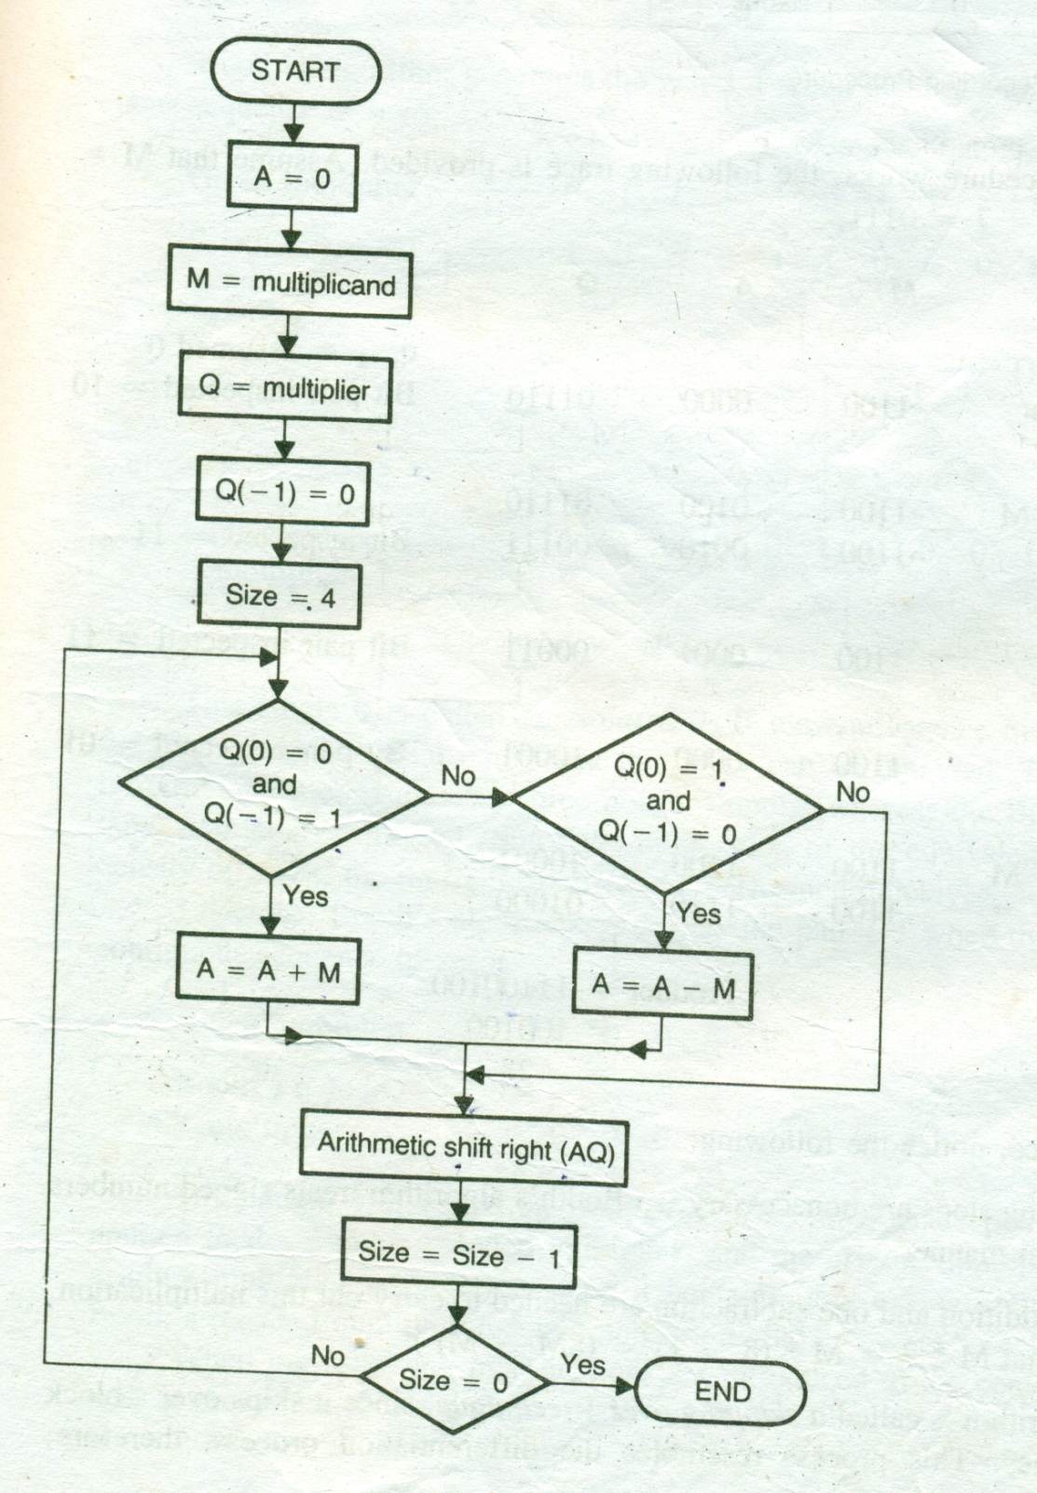
Booth’s Algorithm

Slide 5
15×-15= -225
M | A | Q | Q(-1) | Size | Remarks
01111 | 00000 | 10001 | 0 | 5 | Initialization
01111 | 10001 | 10001 | 0 | 5 | A=A-M
01111 | 11000 | 11000 | 1 | 4 | ARS(AQ),size-1
01111 | 00111 | 11000 | 1 | 4 | A=A+M
01111 | 00011 | 11100 | 0 | 3 | ARS(AQ),size-1
01111 | 00001 | 11110 | 0 | 2 | ARS(AQ),size-1
01111 | 00000 | 11111 | 0 | 1 | ARS(AQ),size-1
01111 | 10001 | 11111 | 0 | 1 | A=A-M
01111 | 11000 | 11111 | 1 | 0 | ARS(AQ),size-1

Slide 6
Solve using Booth’s Algorithm
-13 × -12
-14 × 11
9 × 10

Slide 8
Division Algorithms

Slide 9
Restoring Division
0011 (Quotient=Q)
11(M) 1011 (Q)
11
101
11
10(Remainder=A)

Slide 10
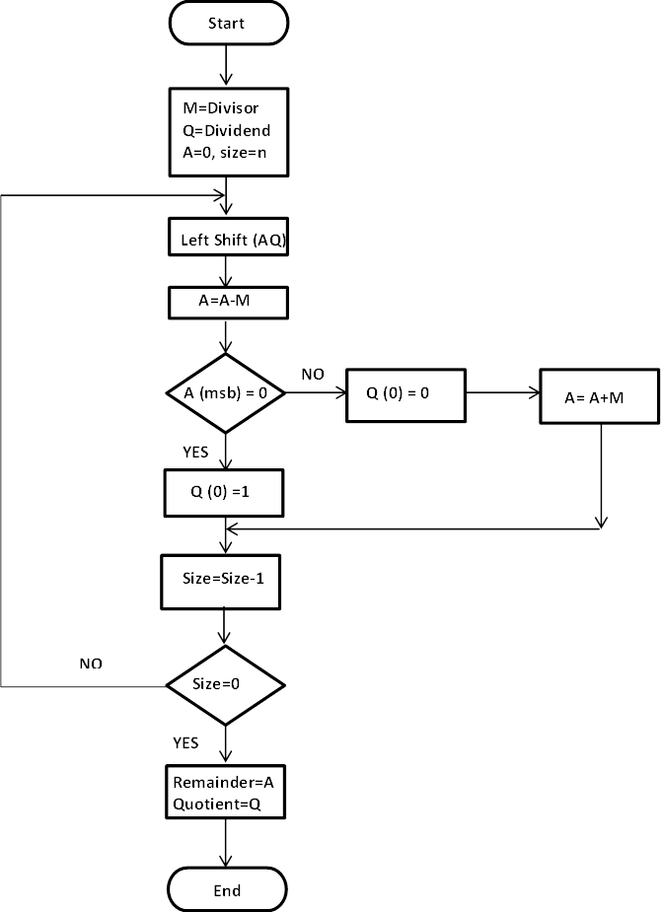

Slide 11
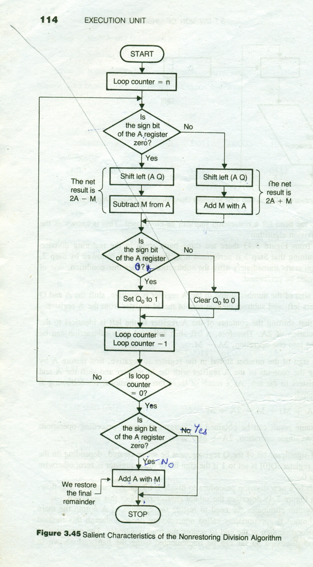
Nonrestoring Division

Slide 12
13 ÷ 4
M | A | Q | Size | Remarks
00100 | 00000 | 1101 | 4 | Initialization
00100 | 00001 | 101_ | 4 | LS(AQ)
00100 | 11101 | 1010 | 3 | A=A-M,size-1
00100 | 11011 | 010_ | 3 | LS(AQ)
00100 | 11111 | 0100 | 2 | A=A+M,size-1
00100 | 11110 | 100_ | 2 | LS(AQ)
00100 | 00010 | 1001 | 1 | A=A+M,size-1
00100 | 00101 | 001_ | 1 | LS(AQ)
00100 | 00001 | 0011 | 0 | A=A-M,size-1
 | Remainder | Quotient

Slide 13
Solve using Non Restoring Division Algorithm
12 ÷ 5
19 ÷ 6

Slide 15
Control Unit

Slide 16
Bus Structure:
Single bus oriented RALU
Two bus oriented RALU
Three bus oriented RALU

Slide 17
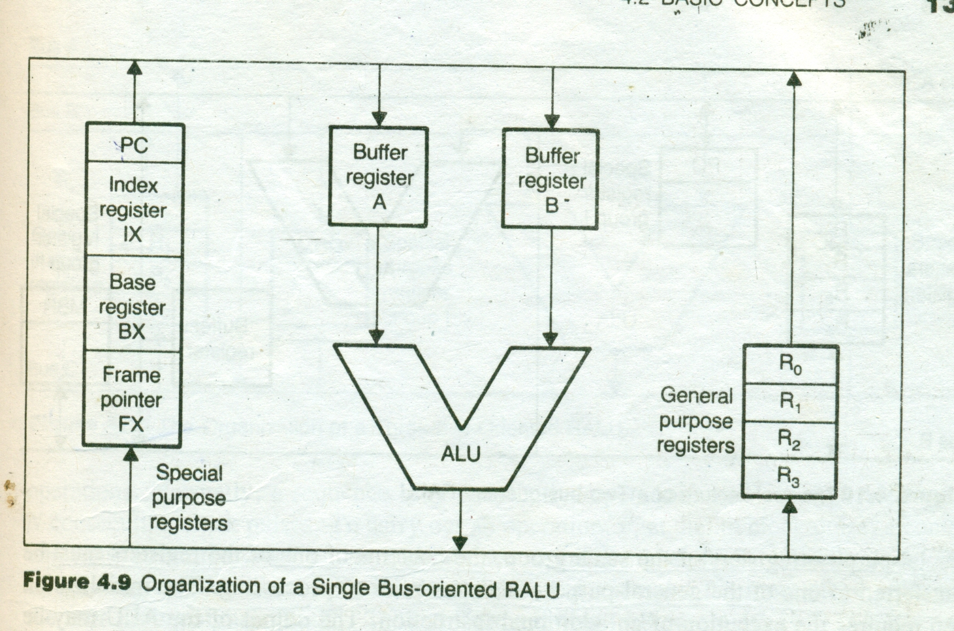

Slide 18
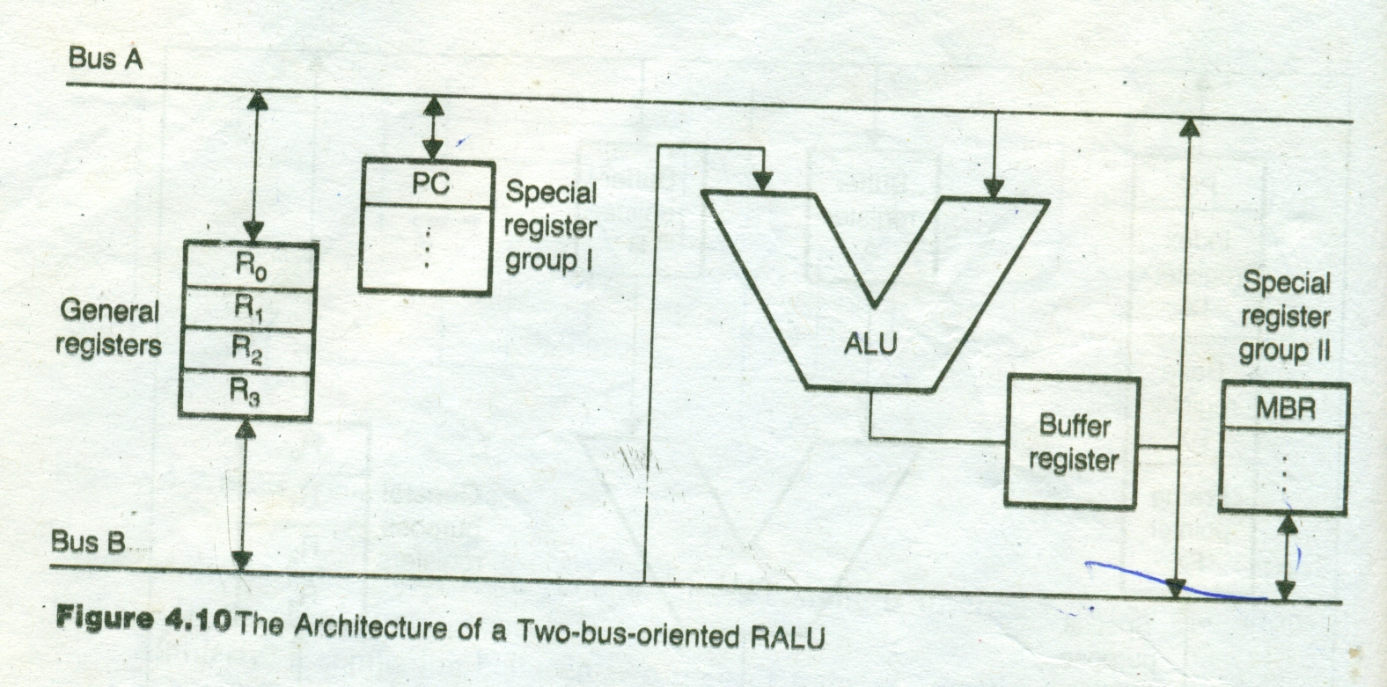

Slide 19
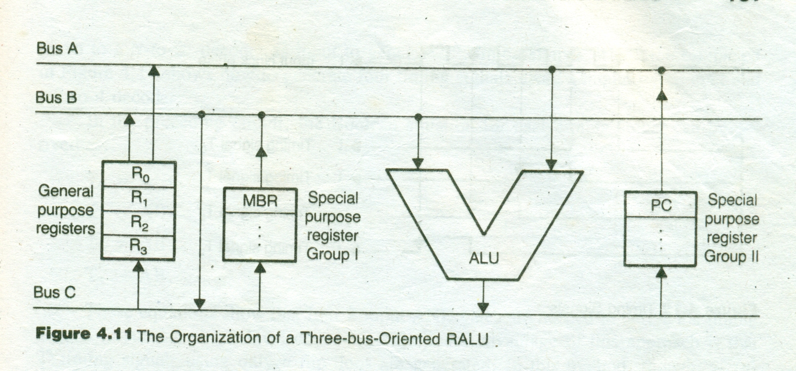

Slide 20
Control unit
A CPU has collection major components
Processing unit: Includes the hardware elements: ALU, shift register, etc..
Control unit: To control system operation by routing the selected data items to the selected processing hardware at right time.

Slide 21
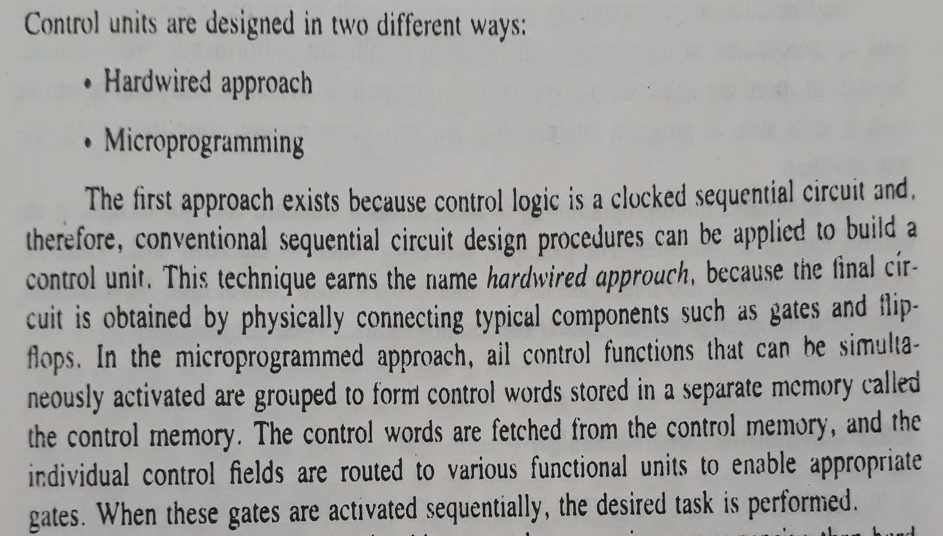
Design Methods

Slide 22
The control hardware can be viewed as a state machine that changes from one state to another in every clock cycle, depending on the contents of the instruction register, the condition codes, and the external inputs.
The outputs of the state machine are the control signals. The sequence of the operation carried out by this machine is determined by the wiring of the logic elements and hence named “hardwired”.

Slide 23
Fixed logic circuits that correspond directly to the Boolean expressions are used to generate the control signals.
Hardwired control is faster than micro-programmed control.
A controller that uses this approach can operate at high speed.
RISC architecture is based on the hardwired control unit

Slide 24
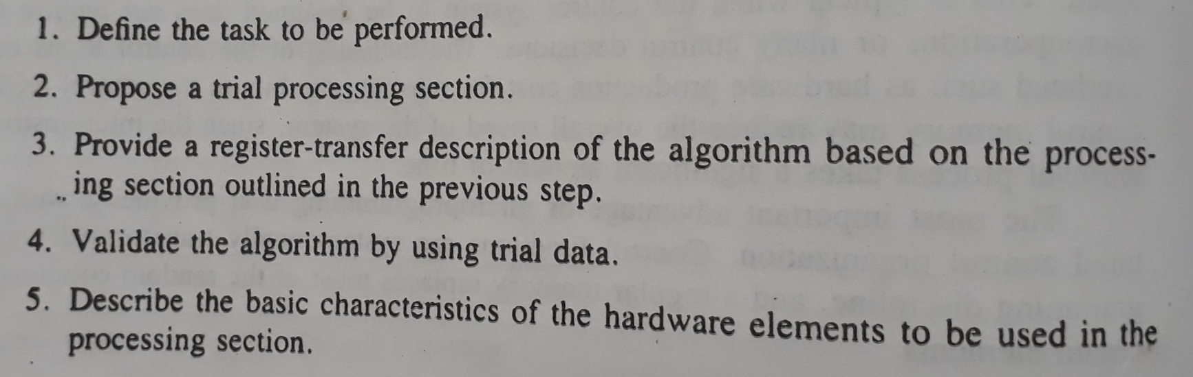
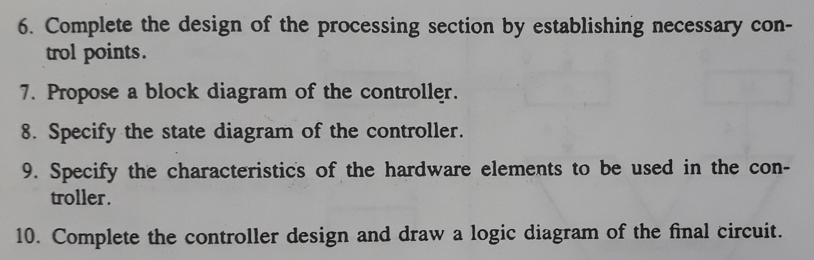
Hardwired Approach

Slide 25
Microprogrammed control unit
The control signals associated with operations are stored in special memory units inaccessible by the programmer as Control Words.
Control signals are generated by a program that is similar to machine language programs.
The micro-programmed control unit is slower in speed because of the time it takes to fetch microinstructions from the control memory.

Slide 26
Some Important Terms
Control Word: A control word is a word whose individual bits represent various control signals.
Micro-routine: A sequence of control words corresponding to the control sequence of a machine instruction constitutes the micro-routine for that instruction.
Micro-instruction: Individual control words in this micro-routine are referred to as microinstructions.
Micro-program: A sequence of micro-instructions is called a micro-program, which is stored in a ROM or RAM called a Control Memory (CM).
Control Store: the micro-routines for all instructions in the instruction set of a computer are stored in a special memory called the Control Store.

Slide 27
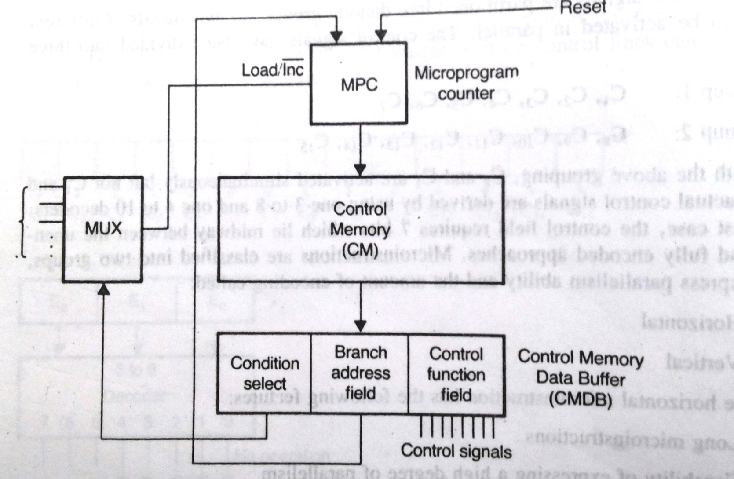
Microprogrammed control unit

Slide 28
 | Hardwired Control Unit | Micro-programmed Control Unit
Implementation | Fixed set of logic gates and circuits | Microcode stored in memory
Flexibility | Less flexible, difficult to modify | More flexible, easier to modify
Instruction Set | Supports limited instruction sets | Supports complex instruction sets
Complexity of Design | Simple design, easy to implement | Complex design, more difficult to implement
Speed | Fast operation | Slower operation due to microcode decoding
Debugging and Testing | Difficult to debug and test | Easier to debug and test
Size and Cost | Smaller size, lower cost | Larger size, higher cost
Maintenance and Upgradability | Difficult to upgrade and maintain | Easier to upgrade and maintain

Slide 29
Cache Memory
Cache memory is an extremely fast memory type that acts as a buffer between RAM and the CPU.
Cache Memory holds frequently requested data and instructions so that they are immediately available to the CPU when needed.
Cache memory is costlier than main memory or disk memory but more economical than CPU registers.
Cache Memory is used to speed up and synchronize with a high-speed CPU.

Slide 30
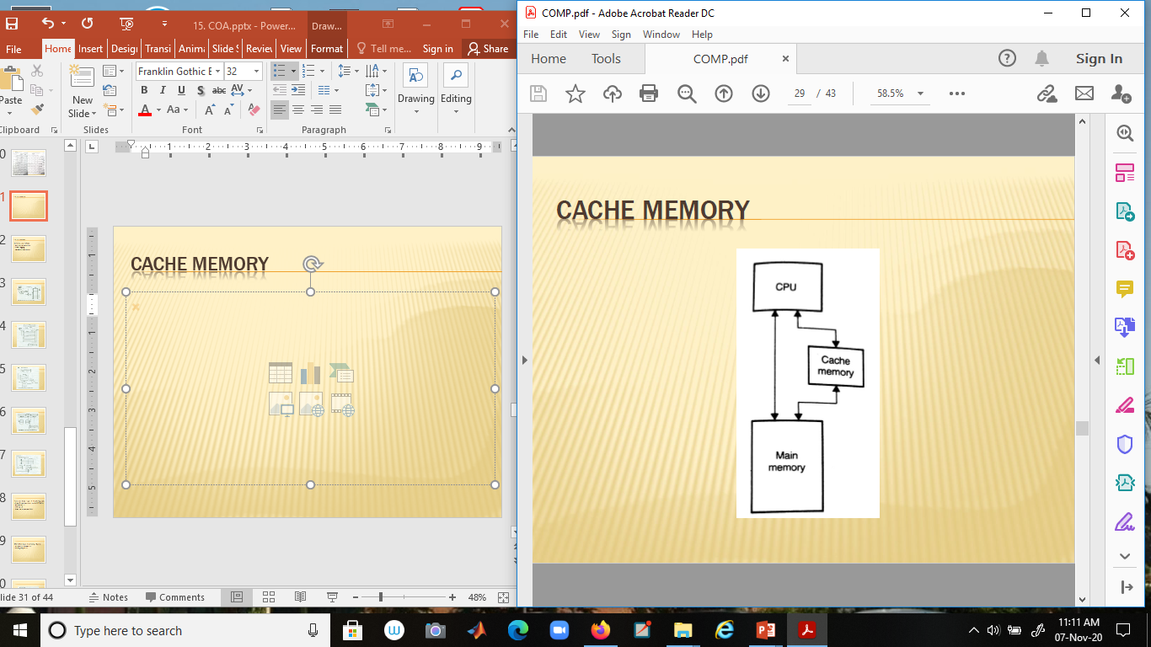
Cache Memory

Slide 31
Cache mapping
Mapping techniques:
Fully Associative Mapping
Direct-Mapping
Set-Associative Mapping

Slide 32
Associative Mapping
In this type of mapping, associative memory is used to store the content and addresses of the memory word.
Any block can go into any line of the cache
This means that the word id bits are used to identify which word in the block is needed but the tag becomes all of the remaining bits
This enables the placement of any word at any place in the cache memory.
It is considered to be the fastest and most flexible mapping form. In associative mapping, the index bits are zero.

Slide 33
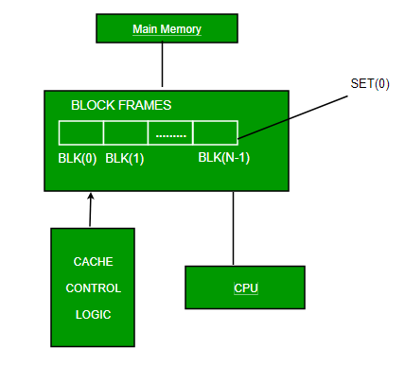

Slide 34
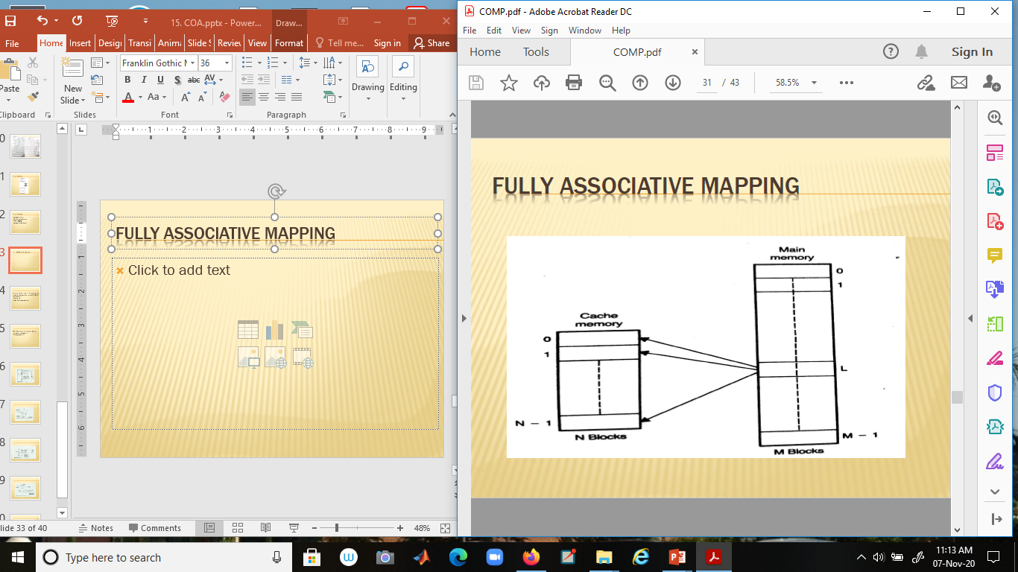
Fully Associative mapping

Slide 35
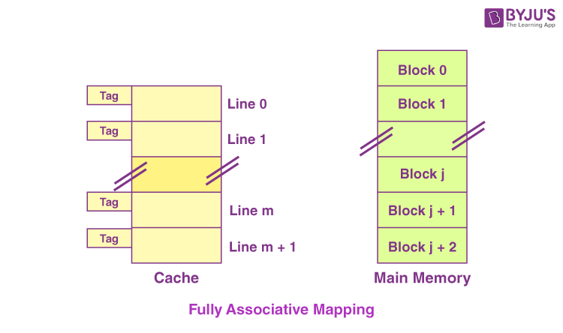
For Example
Let us consider the scenario given as follows:

Slide 36
Here, we can see that,
Every single line of cache is available freely.
Thus, any main memory block can map to a line of the cache.
In case all the cache lines are occupied, one of the blocks that exists already needs to be replaced.

Slide 37
Direct Mapping
The simplest technique, known as direct mapping, maps each block of main memory into only one possible cache line.
assign each memory block to a specific line in the cache.
If a line is previously taken up by a memory block when a new block needs to be loaded, the old block is trashed.

Slide 38
An address space is split into two parts index field and a tag field.
The cache is used to store the tag field whereas the rest is stored in the main memory. Direct mapping`s performance is directly proportional to the Hit ratio.

Slide 39
i = j modulo m
where i = cache line number
j = main memory block number
m = number of lines in the cache

Slide 40
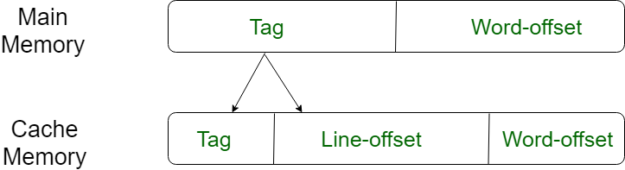
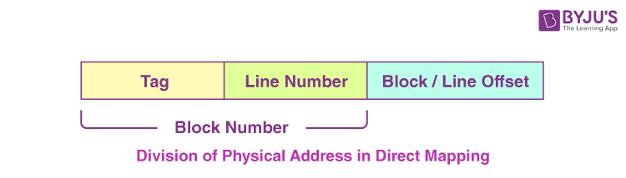

Slide 41
Cache line number = (Address of the Main Memory Block ) Modulo (Total number of lines in Cache)
For example,
Let us consider that particular cache memory is divided into a total of ‘n’ number of lines.
Then, the block ‘j’ of the main memory would be able to map to line number only of the cache (j mod n).

Slide 42
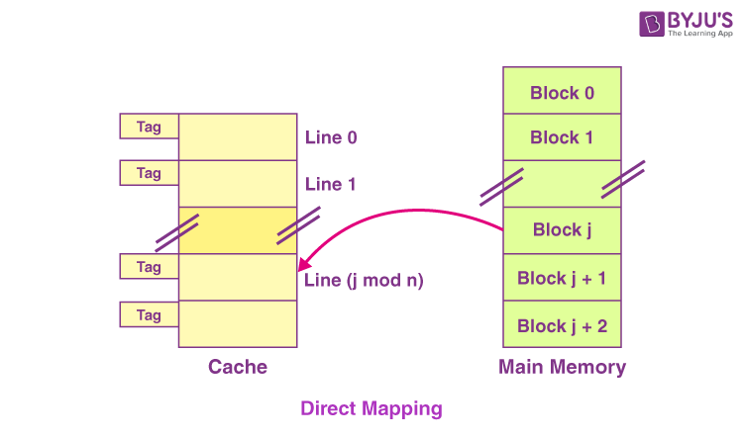

Slide 43
For purposes of cache access, each main memory address can be viewed as consisting of three fields
The least significant w bits identify a unique word or byte within a block of main memory.
In most contemporary machines, the address is at the byte level.
The remaining s bits specify one of the 2^{s} blocks of main memory.
The cache logic interprets these s bits as a tag of s-r bits (the most significant portion) and a line field of r bits.
This latter field identifies one of the m=2^{r} lines of the cache. Line offset is index bits in the direct mapping.

Slide 44
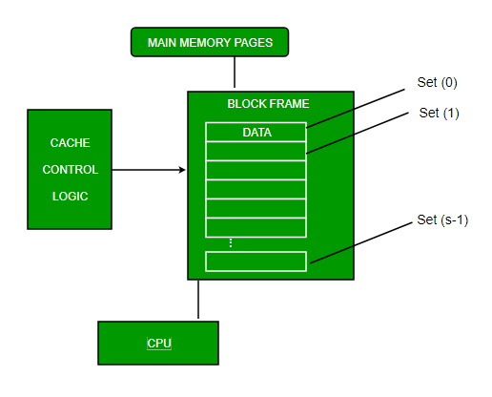

Slide 45
This form of mapping is an enhanced form of direct mapping where the drawbacks of direct mapping are removed
associative addresses the problem of possible thrashing in the direct mapping method
It does this by saying that instead of having exactly one line that a block can map to in the cache, we will group a few lines together creating a set.
Then a block in memory can map to any one of the lines of a specific set
mapping allows each word that is present in the cache can have two or more words in the main memory for the same index address
Set associative cache mapping combines the best of direct and associative cache mapping techniques.
In set associative mapping the index bits are given by the set offset bits. In this case, the cache consists of a number of sets, each of which consists of a number of lines.

Slide 46


Slide 47
m = v * k
i= j mod v where i = cache set number
j = main memory block number
v = number of sets
m = number of lines in the cache number of sets
k = number of lines in each set

Slide 48
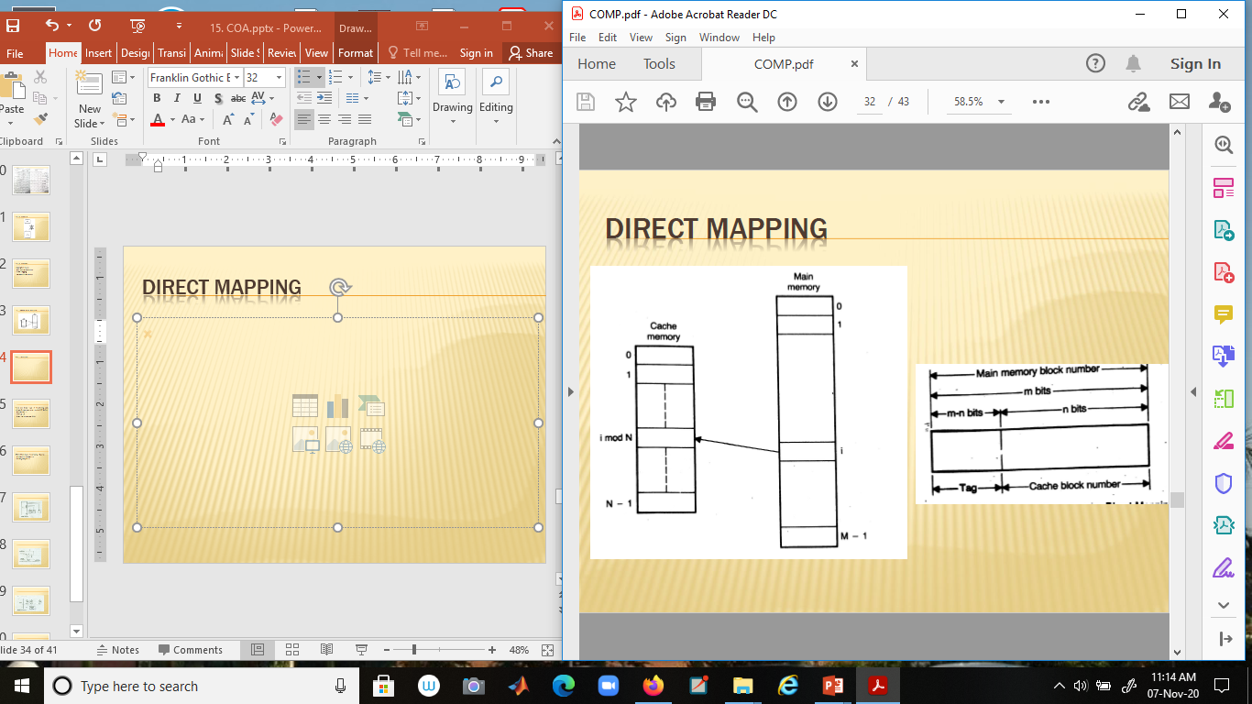
Direct mapping

Slide 49
Set associate mapping
In the case of k-way set associative mapping,
The grouping of the cache lines occurs into various sets where all the sets consist of k number of lines.
Any given main memory block can map only to a particular cache set.
However, within that very set, the block of memory can map any cache line that is freely available.
The cache set to which a certain main memory block can map is basically given as follows:

Slide 50
Cache set number = ( Block Address of the Main Memory ) Modulo (Total Number of sets present in the Cache)
For Example
Let us consider the example given as follows of a two-way set-associative mapping:

Slide 51
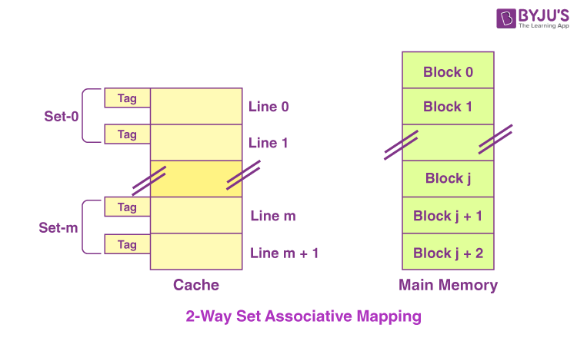

Slide 52
In this case,
k = 2 would suggest that every set consists of two cache lines.
Since the cache consists of 6 lines, the total number of sets that are present in the cache = 6 / 2 = 3 sets.
The block ‘j’ of the main memory is capable of mapping to the set number only (j mod 3) of the cache.
Here, within this very set, the block ‘j’ is capable of mapping to any cache line that is freely available at that moment.
In case all the available cache lines happen to be occupied, then one of the blocks that already exist needs to be replaced.

Slide 53


Slide 54
Special Cases
In case k = 1, the k-way set associative mapping would become direct mapping. Thus,
Direct Mapping = one-way set associative mapping
In the case of k = The total number of lines present in the cache, then the k-way set associative mapping would become fully associative mapping.

Slide 55
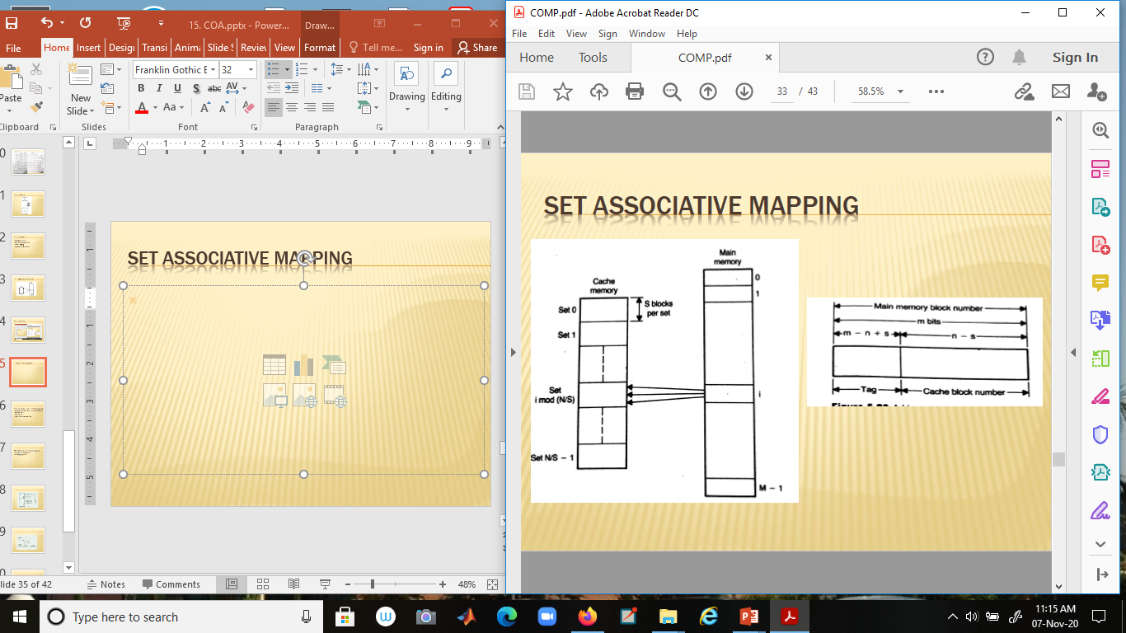
Set associative mapping

Slide 56
Direct Mapping: Each block from main memory has only one possible place in the cache organization in this technique. For example : every block i of the main memory can be mapped to block j of the cache using the formula :
j = i modulo m
Where : i = main memory block number j = cache block number m = number of blocks in the cache

Slide 57
The address here is divided into 3 fields : Tag, Block & Word.
To map the memory address to cache: The BLOCK field of the address is used to access the cache’s BLOCK. Then, the tag bits in the address is compared with the tag of the block. For a match, a cache hit occurs as the required word is found in the cache. Otherwise, a cache miss occurs and the required word has to be brought into the cache from the Main Memory. The word is now stored in the cache together with the new tag (old tag is replaced).

Slide 59
Example: If we have a fully associative mapped cache of 8 KB size with block size = 128 bytes and say, the size of main memory is = 64 KB. (Assuming word size = 1 byte) Then :
Number of bits for the physical address = 16 bits (as memory size = 64 KB = 2⁶ × 2¹⁰ = 2¹⁶⁾ Number of bits for WORD = 7 bits (as block size = 128 bytes = 2⁷) No of Index bits = 13 bits (as cache size = 8 KB = 2³ × 2¹⁰ = 2¹³⁾ No of BLOCK bits = Number of Index bits- Number of bits for WORD = 13 – 7 = 6bits

Slide 60
OR (No of cache Blocks = Cache size/block size = 8 KB / 128 Bytes = 8×1024 Bytes/128 Bytes = 2⁶ blocks → 6bits) No of TAG bits = Number of bits for the physical address — Number of bits in Index = 16-13 = 3 bits

Slide 61
Associative Mapping:
Here the mapping of the main memory block can be done with any of the cache block. The memory address has only 2 fields here: word & tag. This technique is called as fully associative cache mapping.

Slide 62
Fully Associative mapping

Slide 63
Example: If we have a fully associative mapped cache of 8 KB size with block size = 128 bytes and say, the size of main memory is = 64 KB. Then:
Number of bits for the physical address = 16 bits (as memory size = 64 KB = 2⁶ × 2¹⁰ = 2¹⁶⁾
Number of bits in block offset = 7 bits (as block size = 128 bytes = 2⁷) No of tag bits = Number of bits for the physical address – Number of bits in block offset = 16-7 = 9 bits No of cache Blocks = Cache size/block size = 8 KB / 128 Bytes = 8×1024 Bytes/128 Bytes = 2⁶ blocks.

Slide 64
Set – Associative Mapping:
It is the combination of advantages of both direct & associative mapping. Here, the cache consists of a number sets, each of which consists of a number of blocks. The relationships are :
n = w * L i = j modulo w
where i : cache set number
j : main memory block number
n : number of blocks in the cache
w : number of sets
L : number of lines in each set

Slide 65
To map the memory address to cache: Using set field in the memory address, we access the particular set of the cache.
Then, the tag bits in the address are compared with the tag of all L blocks within that set.
For a match, a cache hit occur as the required word is found in the cache.
Otherwise, a cache miss occurs and the required word has to be brought in the cache from the Main Memory.
According to the replacement policy used, a replacement is done if the cache is full.

Slide 66
Set associative mapping

Slide 67
Example: If we have a fully associative mapped cache of 8 KB size with block size = 128 bytes and say, the size of main memory is = 64 KB, and we have “2-way” set-associative mapping (Assume each word has 8 bits). Then :
Number of bits for the physical address = 16 bits (as memory size = 64 KB = 2⁶ * 2¹⁰ = 2¹⁶⁾ No of cache Blocks = Cache size/block size = 8 KB / 128 Bytes = 8×1024 Bytes/128 Bytes = 2⁶ cache blocks. No of Main Memory Blocks = MM size/block size = 64 KB / 128 Bytes = 64×1024 Bytes/128 Bytes = 2⁹ MM blocks. No of sets of size 2 = No of Cache Blocks/ L = 2⁶/2 = 2⁵ cache sets.(L = 2 as it is 2-way set associative mapping)

Slide 68
Direct-mapping | Associative Mapping | Set-Associative Mapping
Needs only one comparison because of using direct formula to get the effective cache address. | Needs comparison with all tag bits, i.e., the cache control logic must examine every block’s tag for a match at the same time in order to determine that a block is in the cache/not. | Needs comparisons equal to number of blocks per set as the set can contain more than 1 blocks.
Main Memory Address is divided into 3 fields : TAG, BLOCK & WORD. The BLOCK & WORD together make an index. The least significant TAG bits identify a unique word within a block of main memory, the BLOCK bits specify one of the blocks and the Tag bits are the most significant bits. | Main Memory Address is divided into 1 fields : TAG & WORD. | Main Memory Address is divided into 3 fields : TAG, SET & WORD.
There is one possible location in the cache organization for each block from main memory because we have a fixed formula. | The mapping of the main memory block can be done with any of the cache block. | The mapping of the main memory block can be done with a particular cache block of any direct-mapped cache.
If the processor need to access same memory location from 2 different main memory pages frequently, cache hit ratio decreases. | If the processor need to access same memory location from 2 different main memory pages frequently, cache hit ratio has no effect. | In case of frequently accessing two different pages of the main memory if reduced, the cache hit ratio reduces.
Search time is less here because there is one possible location in the cache organization for each block from main memory. | Search time is more as the cache control logic examines every block’s tag for a match. | Search time increases with number of blocks per set.
The index is given by the number of blocks in cache. | The index is zero for associative mapping. | The index is given by the number of sets in cache.
It has least number of tag bits. | It has the greatest number of tag bits. | It has less tags bits than associative mapping and more tag bits than direct mapping.
Advantages- Simplest type of mapping Fast as only tag field matching is required while searching for a word. It is comparatively less expensive than associative mapping. | Advantages- It is fast. Easy to implement | Advantages- It gives better performance than the direct and associative mapping techniques.
Disadvantages- It gives low performance because of the replacement for data-tag value. | Disadvantages- Expensive because it needs to store address along with the data. | Disadvantages- It is most expensive as with the increase in set size cost also increases.

Slide 69
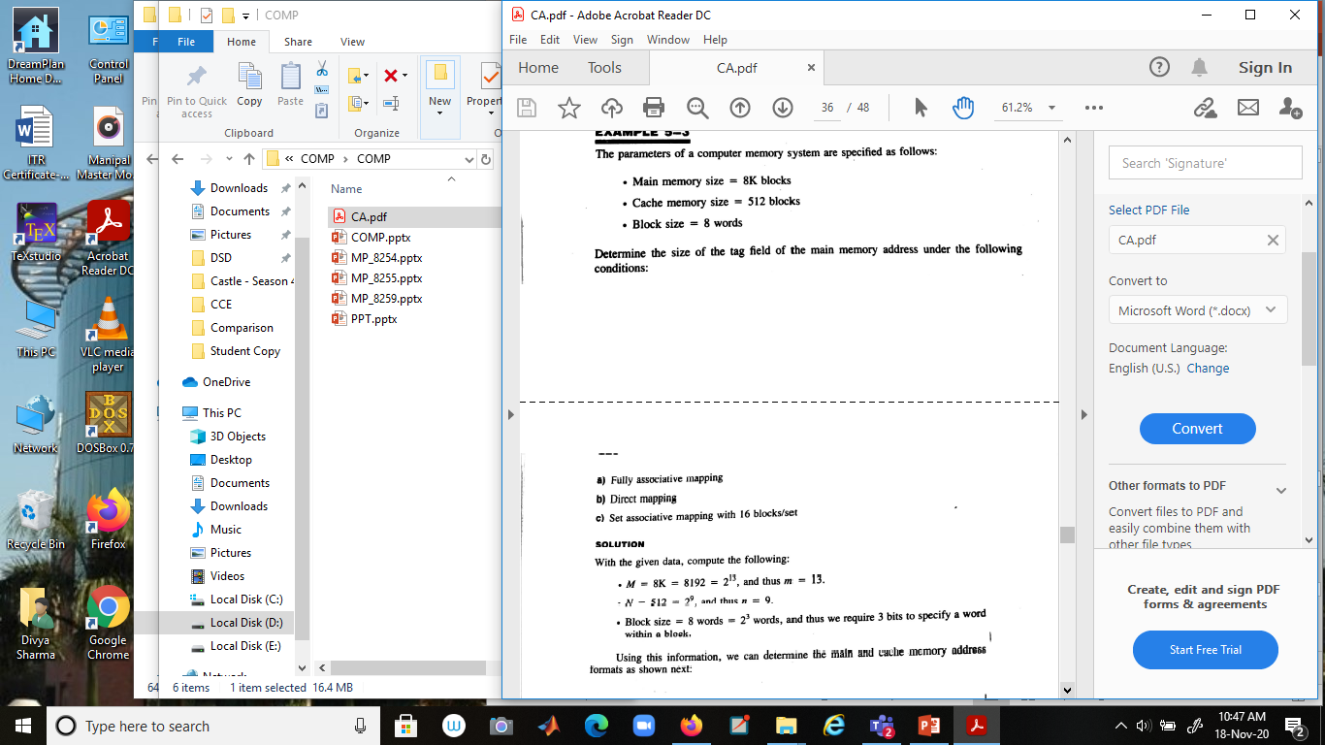

Slide 70
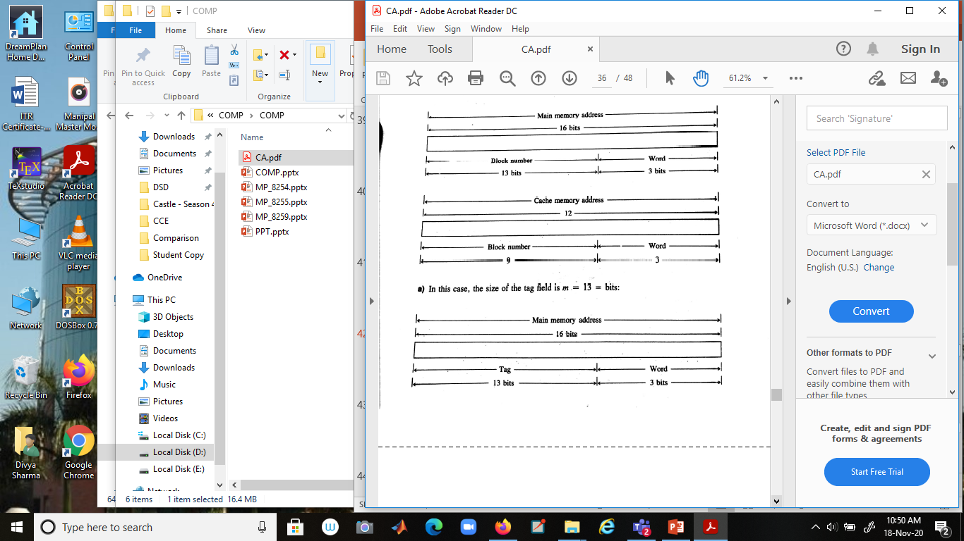

Slide 71
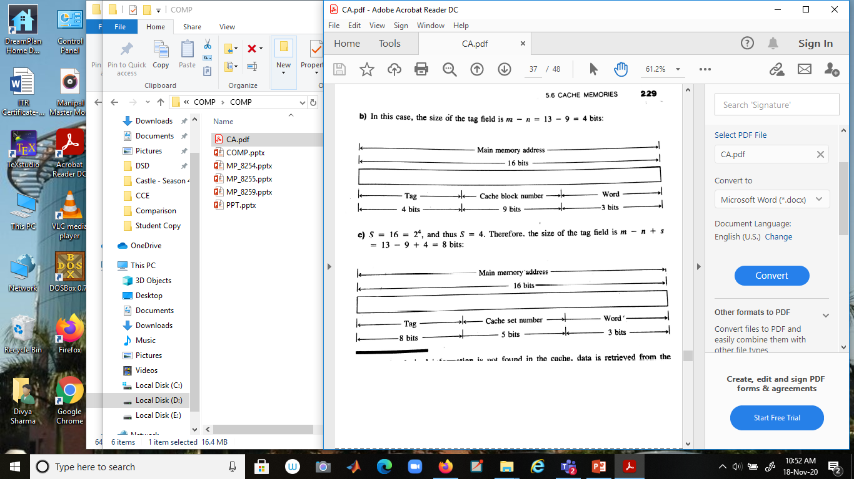

Slide 72
Input/output(I/0) Modern computer architecture by mohamed rafiquzzaman and rajan chandra

Slide 73
There are three ways of transferring data between the computer and a physical I/O device:
Programmed I/O: The computer executes a program to communicate with an external device through a register called the I/O port.
Interrupt I/O: The computer executes a program called ISR to carry out the function requested by the external device.
Direct memory access (DMA): Data transfer between the memory and the external device takes place without the involvement of the CPU.

Slide 74
Programmed I/O
Different techniques of addressing I/O ports:
Standard I/O (isolated I/O)
Uses I/O/ pin.
I/O ports are separate.
Uses IN and OUT instructions to access I/O Ports.
The I/O port data must be moved into accumulator for processing.
Memory mapped I/O
Does not use I/O/ pin
I/O ports are mapped to the processor’s memory
MSB of the address indicates I/O or memory operation. If MSB=1, I/O port is selected and if MSB=0, Memory is accessed.
Processor can perform operation on port data without moving into the CPU

Slide 75
Interrupt I/O
There are two ways of servicing multiple interrupts:
Polled technique
Daisy chain technique

Slide 76
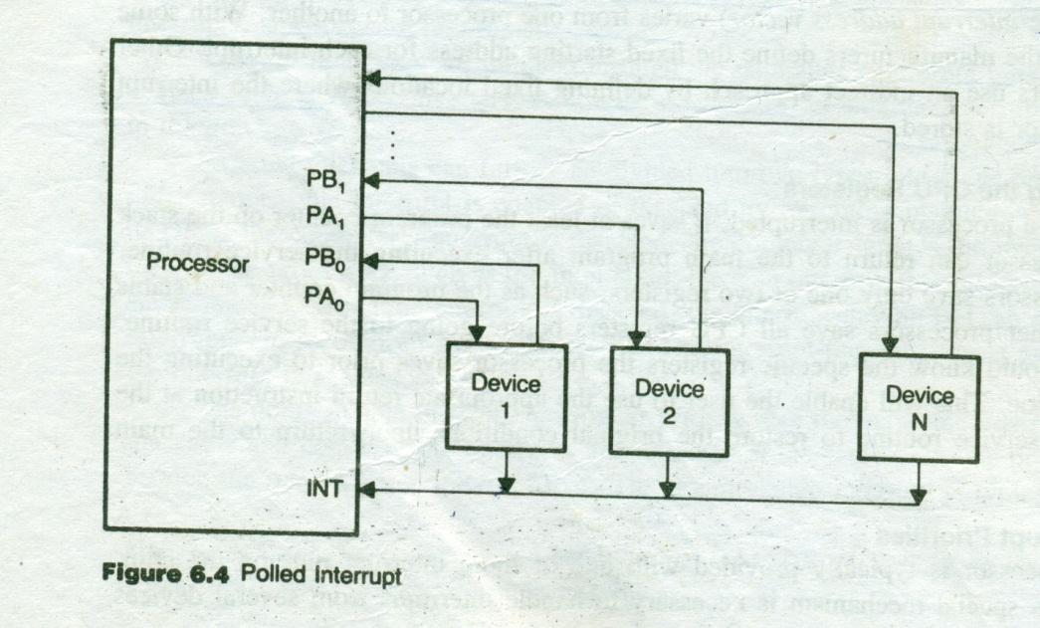
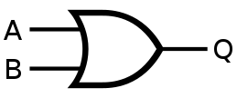
Polled technique
Handled by software
One general service routine is used for all devices.
Priority is with respect to how the ISR poll each device.
Once the source of interrupt is identified, it branches to the service routine for the device.

Slide 77
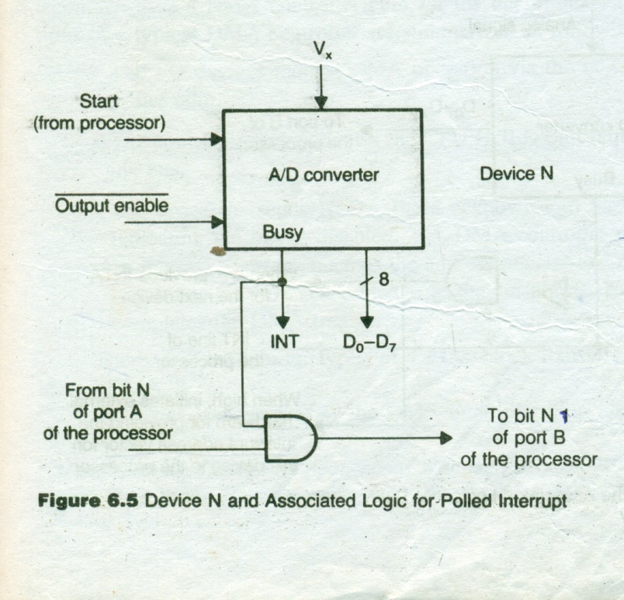

Slide 78
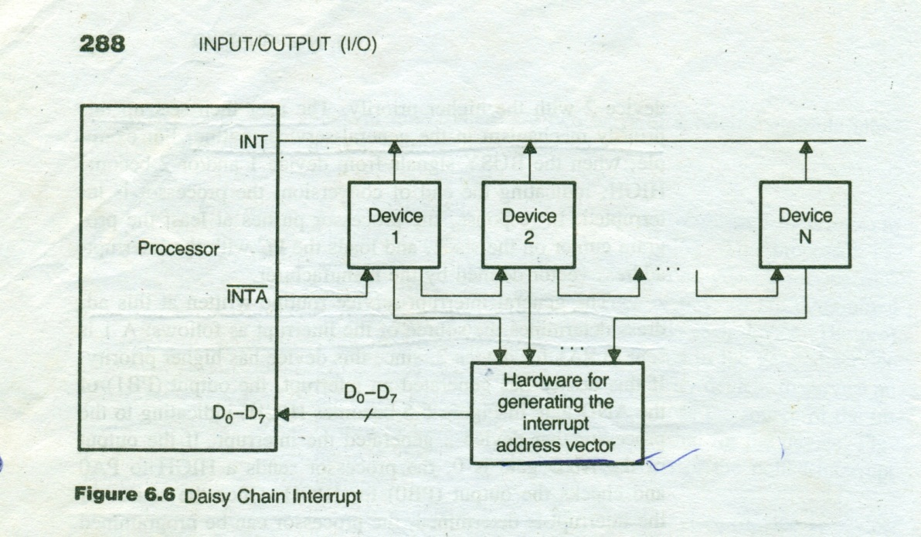
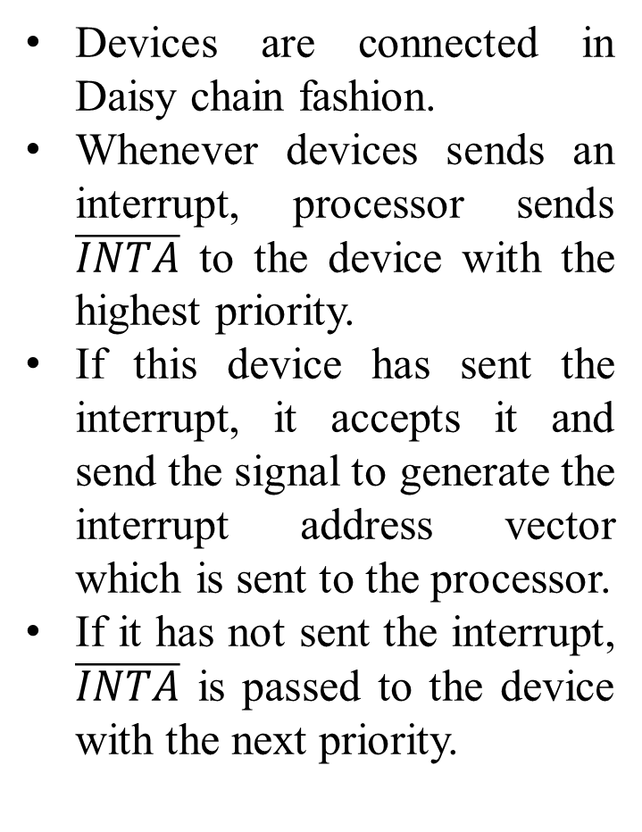
Daisy chain technique
Devices are connected in Daisy chain fashion.
Whenever devices sends an interrupt, processor sends $\overline{INTA}$ to the device with the highest priority.
If this device has sent the interrupt, it accepts it and send the signal to generate the interrupt address vector which is sent to the processor.
If it has not sent the interrupt, $\overline{INTA}$ is passed to the device with the next priority.

Slide 79
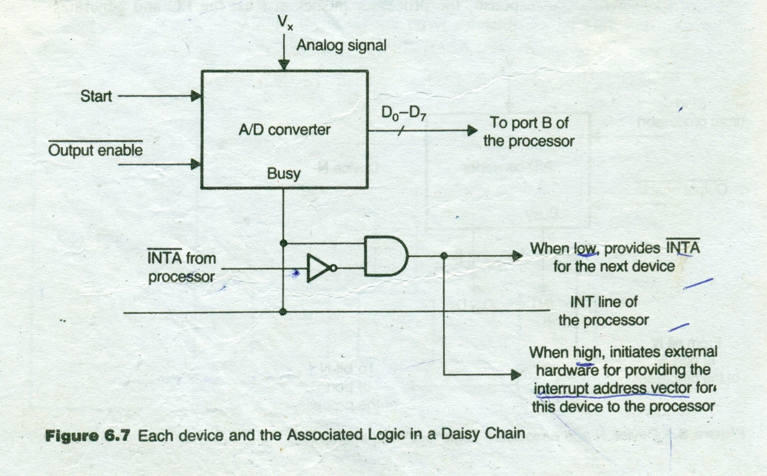

Slide 80
Direct memory access(DMA)
There are three basic types of DMA:
Cycle stealing
Interleaved
Block transfer

Slide 81
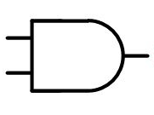
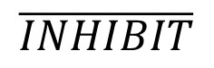
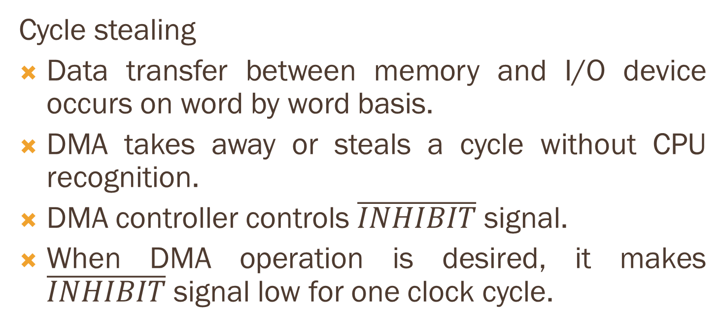
Cycle stealing
Data transfer between memory and I/O device occurs on word by word basis.
DMA takes away or steals a cycle without CPU recognition.
DMA controller controls $\overline{INHIBIT}$ signal.
When DMA operation is desired, it makes $\overline{INHIBIT}$ signal low for one clock cycle.
$$\overline{INHIBIT}$$
CPU Clock
System Clock

Slide 82
Interleaved DMA
DMA controller takes over the bus when the CPU is not using it.
For example: When CPU is performing ALU operation or incrementing the pointer.
Data transfer takes place for a period of time.

Slide 83
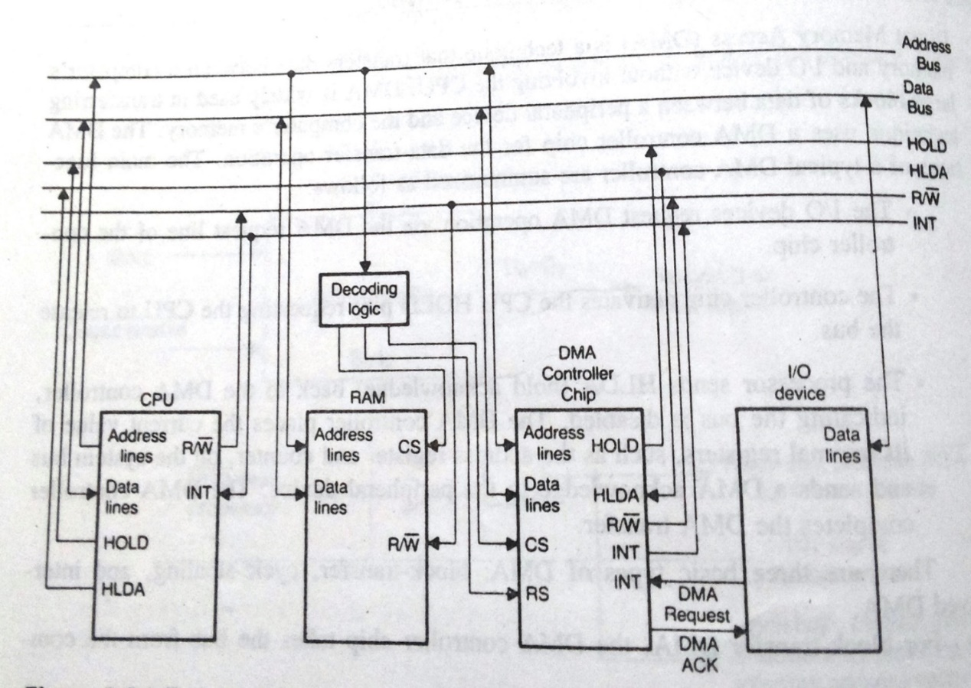
Block transfer DMA
I/O device requests for the DMA using DMA request line.
DMA controller chip then sends a HOLD signal to the CPU.
Waits for HLDA signal from the CPU.
When DMA controller receives HLDA, it sends DMA ACK to I/O device.
On completion of the data transfer, controller sends INT to the CPU and returns the bus to CPU.
DMA controller chip has three registers:
Address register
Terminal count register
Status register

